Slide 1
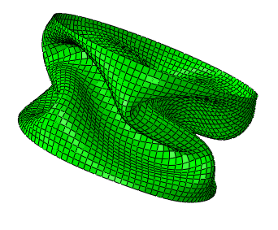
Post-Buckling Twisting of Soft Cylinders
Helen Read
ES 242R Final Project

Slide 2
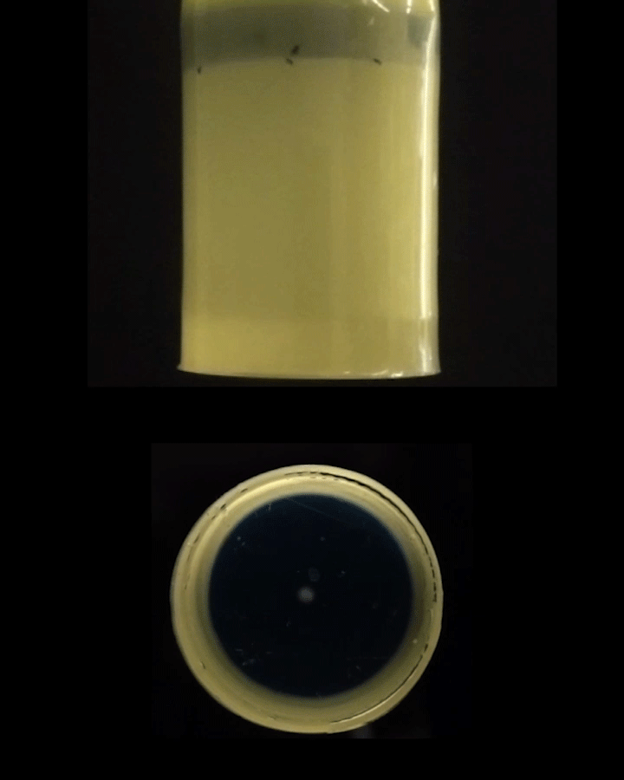
Background
This is an ongoing project of my labmate, Yi Yang
FEM work was previously done by David Melancon
We suction air out of thin-walled soft cylinders
Two regimes of behavior:
(1) initial buckling event that creates folds and
(2) twisting of cylinder (for # folds > 2)

Slide 3
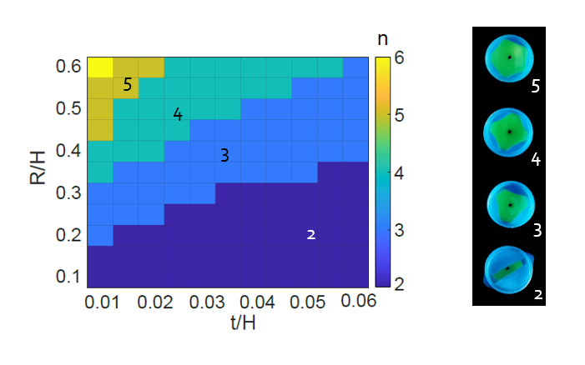
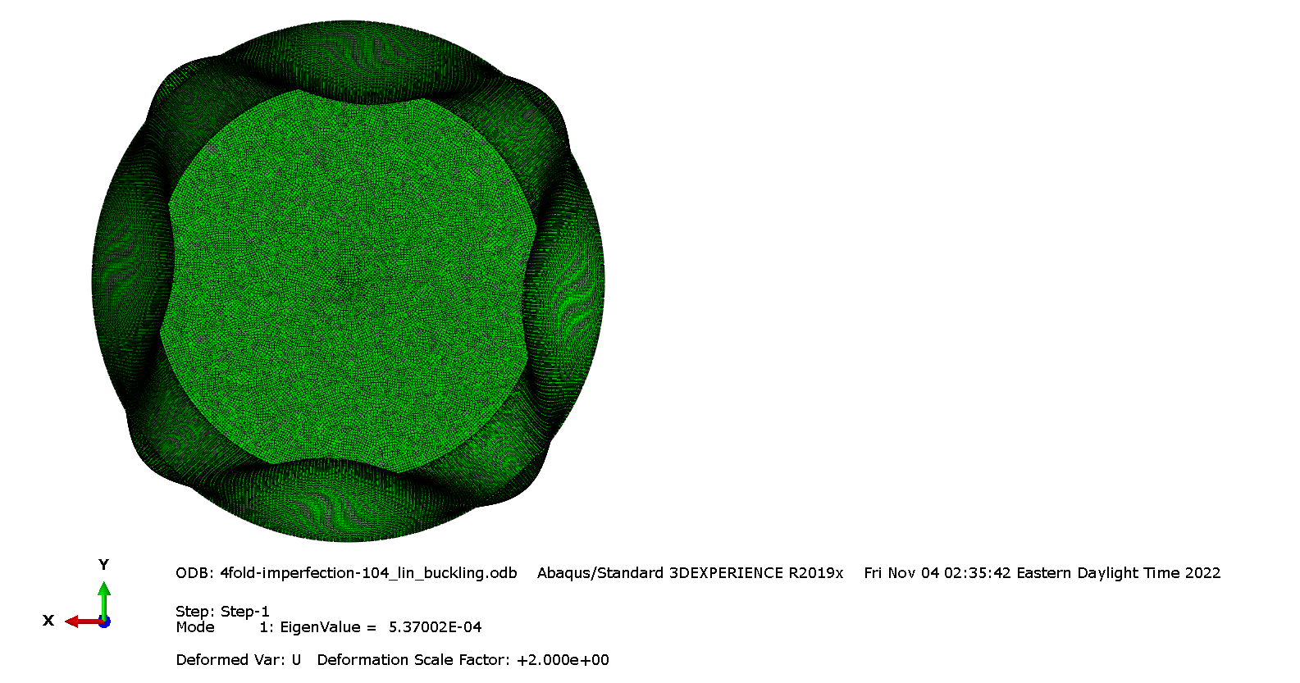
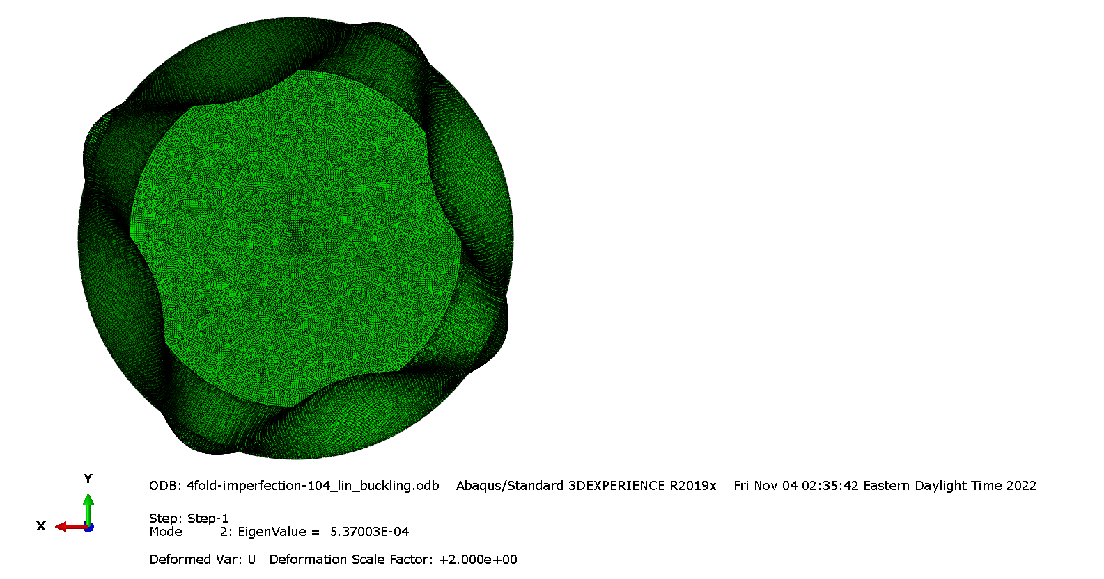
Background
The initial regime of buckling is well understood
Can be captured by a buckling step in abaqus
An analytical model exists too!
The post-buckling twisting behavior is less well understood

Slide 4
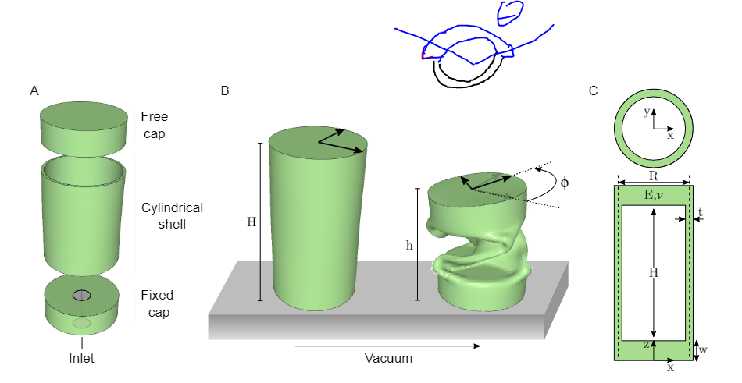
Simulation Geometry
We have 3 parts
2 caps (free and fixed)
1 shell
For simplicity, we fix the edge of the cylindrical shell instead of modeling the fixed cap
All elements used are S4R shells

Slide 5
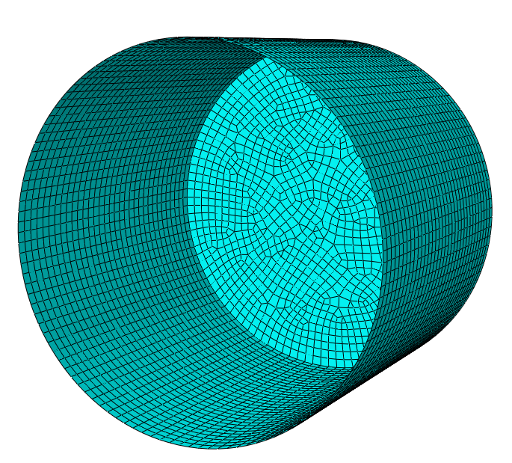
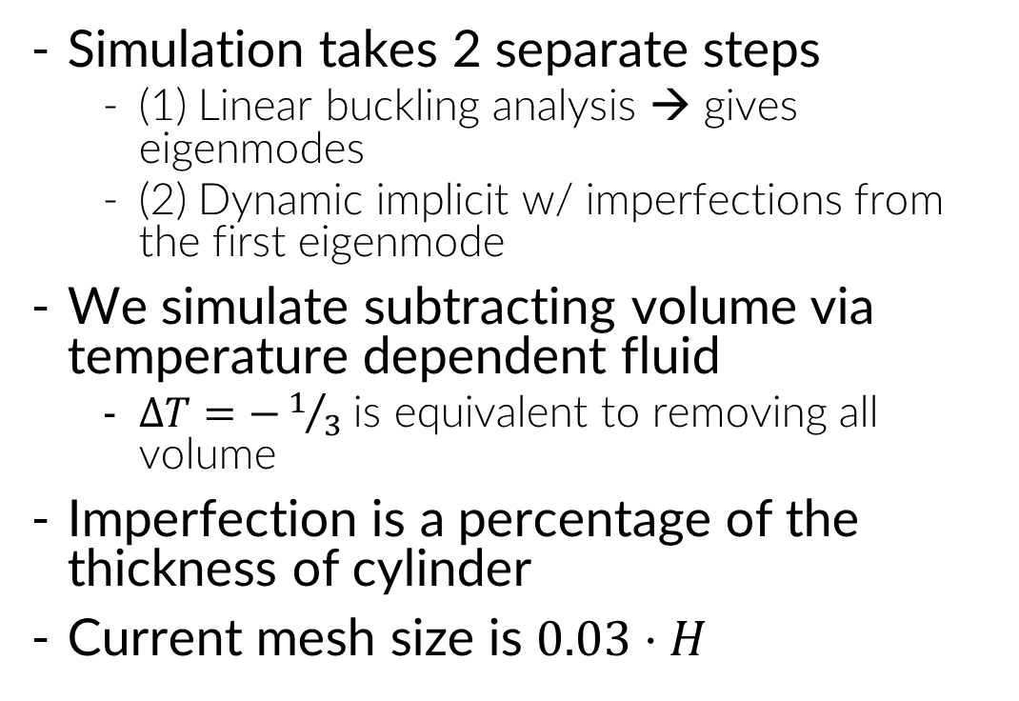
Simulation Setup
Simulation takes 2 separate steps
(1) Linear buckling analysis → gives eigenmodes
(2) Dynamic implicit w/ imperfections from the first eigenmode
We simulate subtracting volume via temperature dependent fluid
$ΔT=−1/3$ is equivalent to removing all volume
Imperfection is a percentage of the thickness of cylinder
Current mesh size is $0.03⋅H$

Slide 6
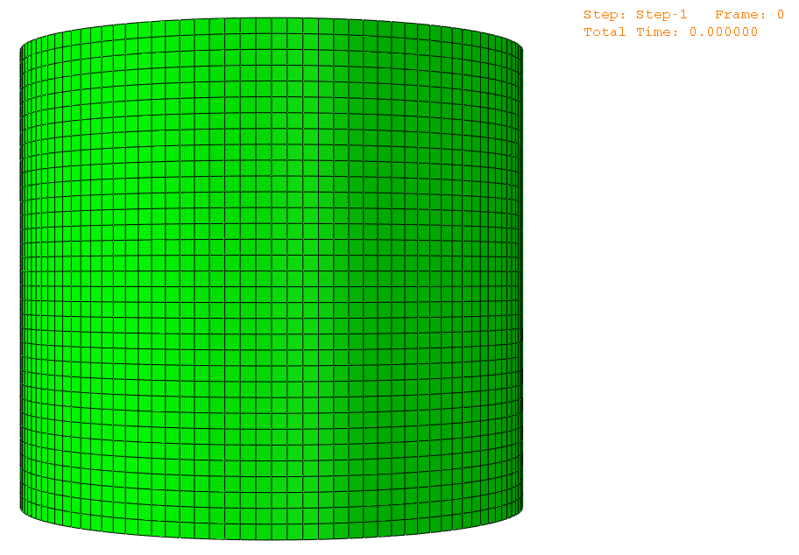
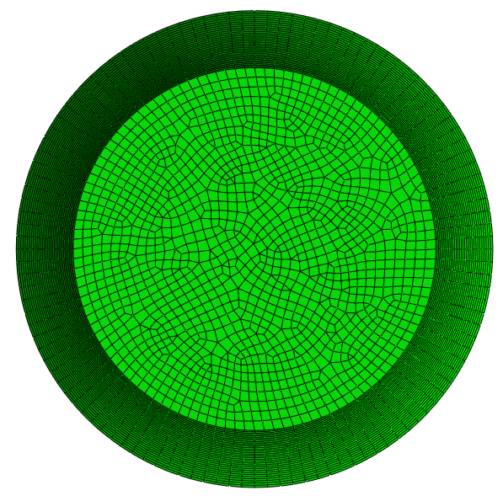
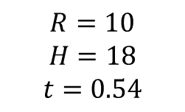
Dynamic Implicit Results
$$R=10$$
$$H=18$$
$$t=0.54$$

Slide 7
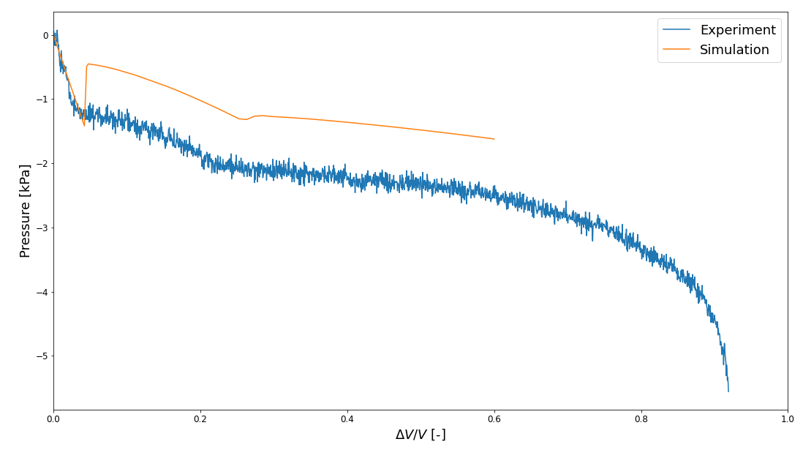
Comparison to Experiments

Slide 8
Is this twisting a secondary buckling event?

Slide 9
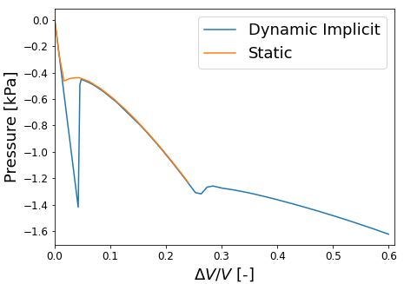
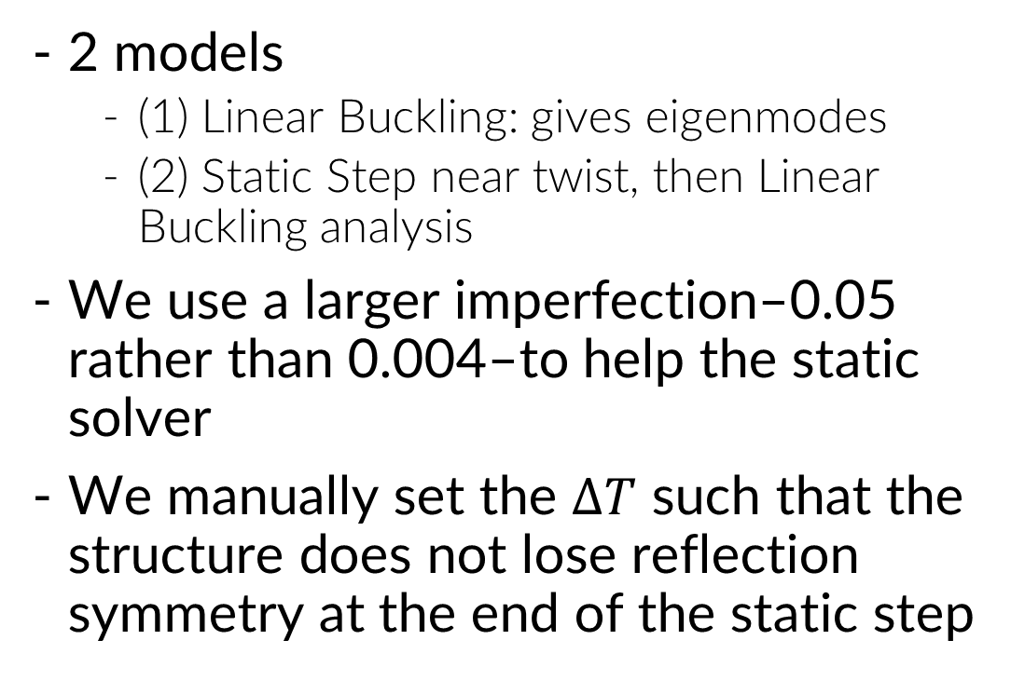
Secondary Buckling Analysis
2 models
(1) Linear Buckling: gives eigenmodes
(2) Static Step near twist, then Linear Buckling analysis
We use a larger imperfection–0.05 rather than 0.004–to help the static solver
We manually set the $ΔT$ such that the structure does not lose reflection symmetry at the end of the static step

Slide 10
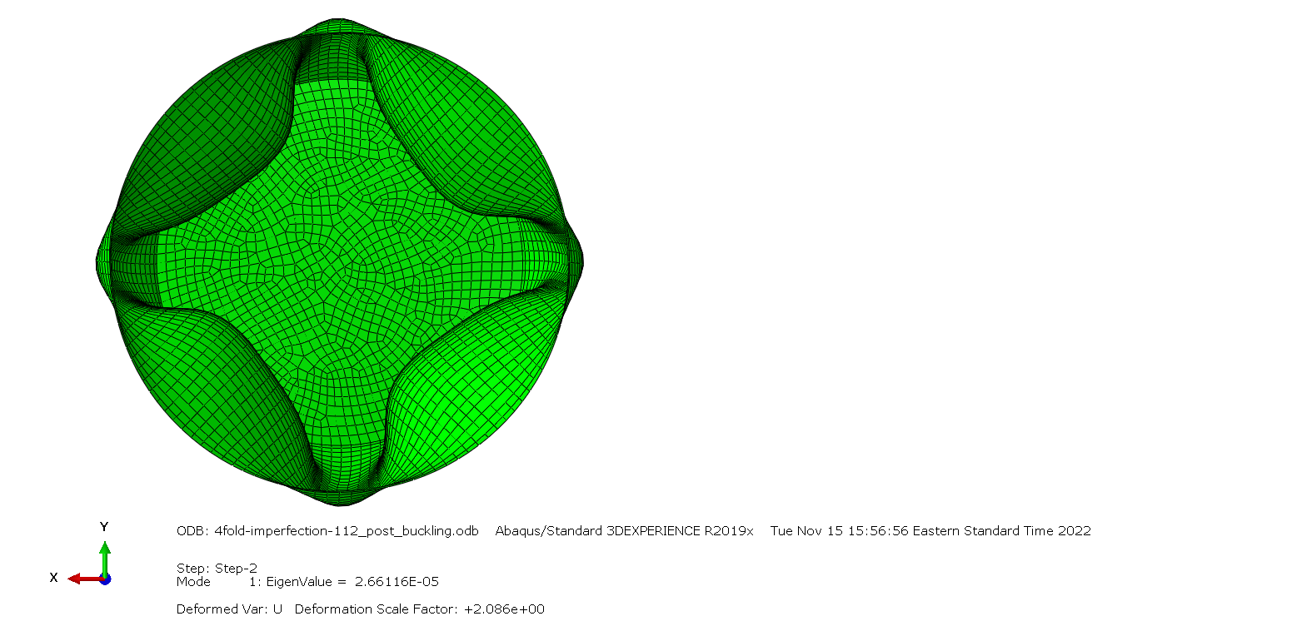
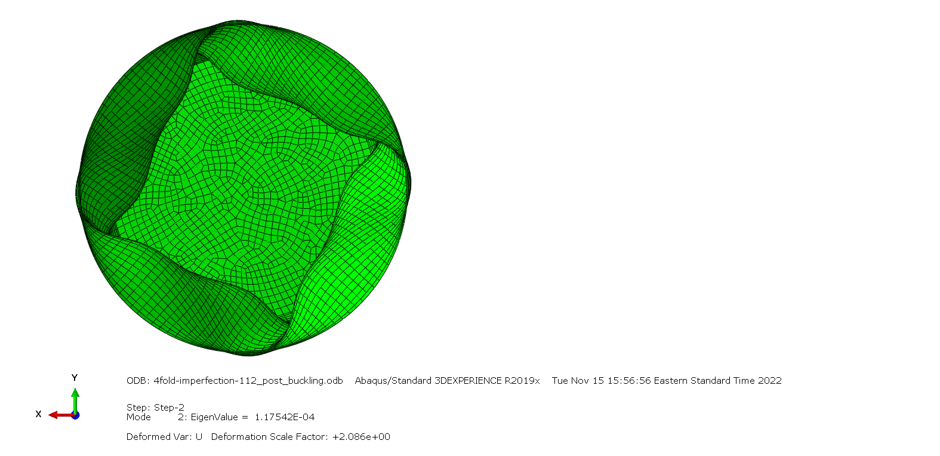
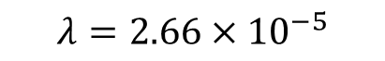
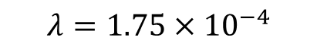
Secondary Buckling Modes
$$λ=2.66×{10}^{−5}$$
$$λ=1.75×{10}^{−4}$$

Slide 11
How can we understand what causes the onset of twisting?

Slide 12
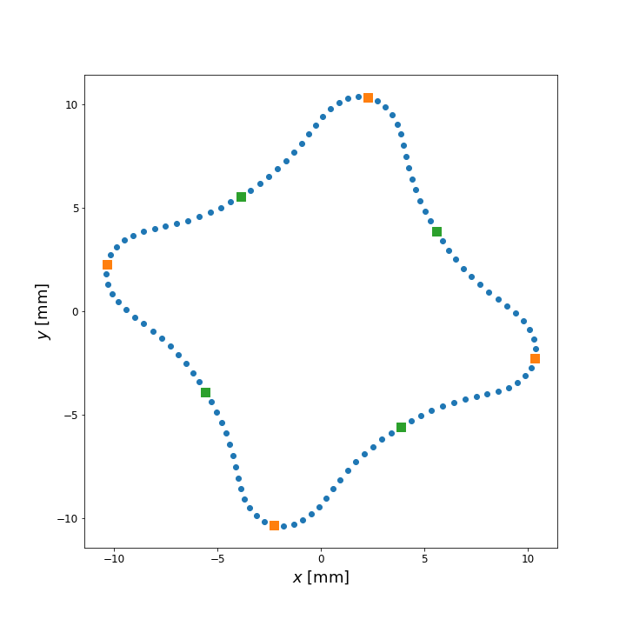
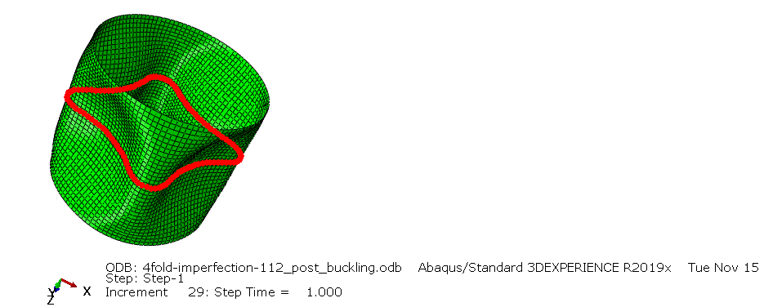
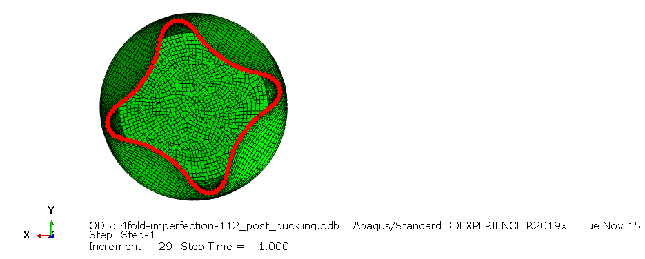
Analysis of Center Nodes

Slide 13
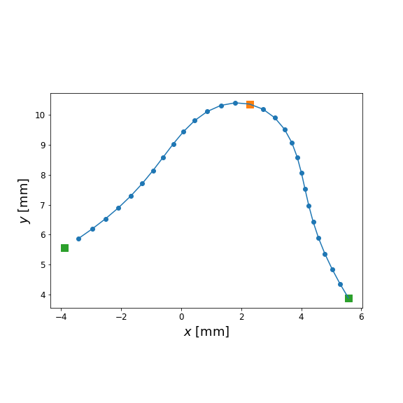
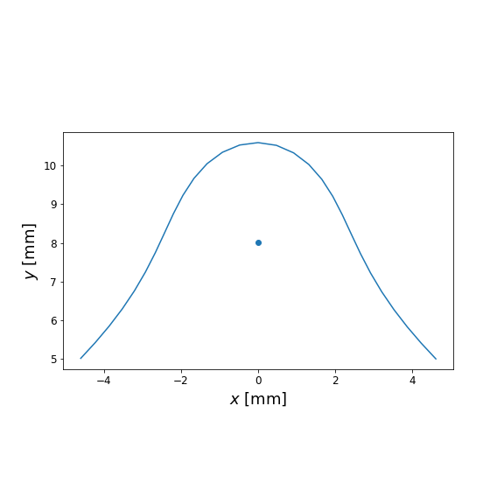
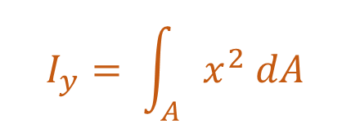
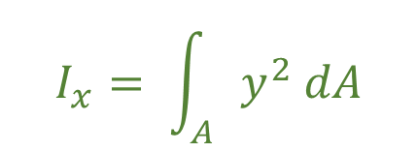
Looking at a Quarter
$$I_{x}= \int_{A}{y^{2} dA}$$
$$I_{y}= \int_{A}{x^{2} dA}$$

Slide 14
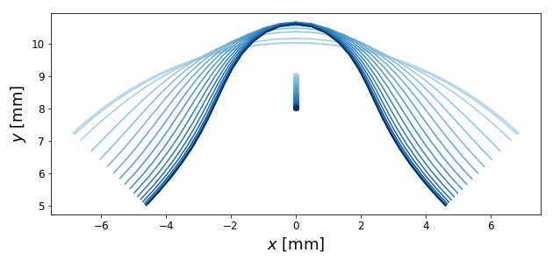
Evolving Shape
t

Slide 15
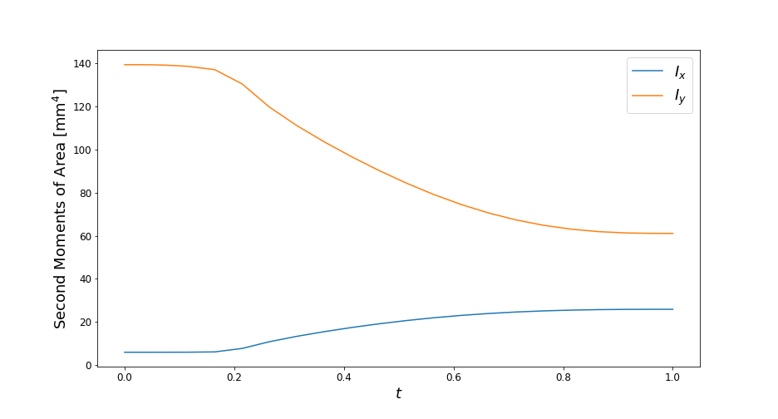
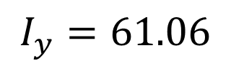
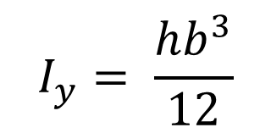
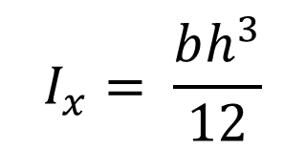
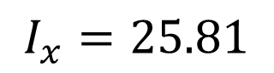
Moments of Area
$$I_{y}= \frac{hb^{3}}{12}$$
$$I_{y}=61.06$$
$$I_{x}= \frac{bh^{3}}{12}$$
$$I_{x}=25.81$$

Slide 16
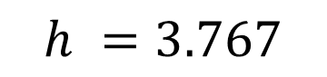
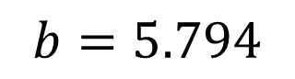
Simplified Beam Model
$$h =3.767$$
$$b=5.794$$

Slide 17
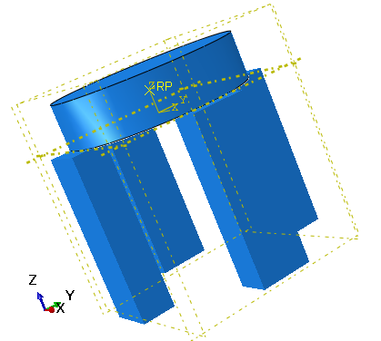
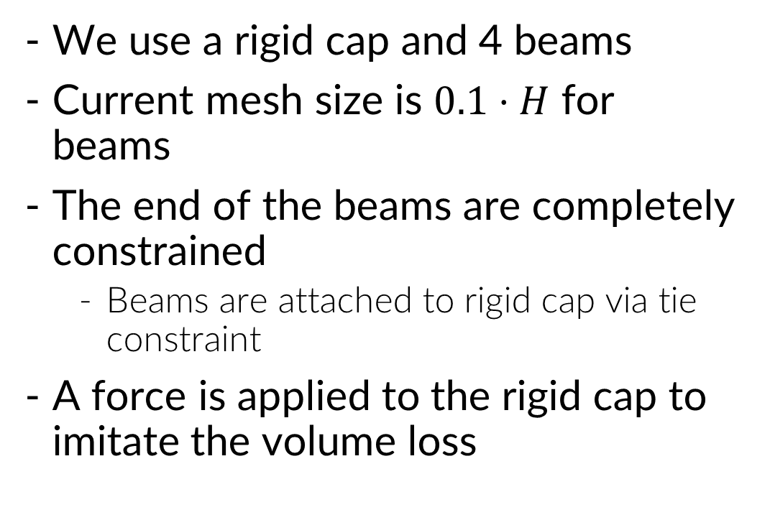
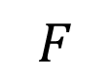
Buckling of Beam Model
$$F$$
We use a rigid cap and 4 beams
Current mesh size is $0.1⋅H$ for beams
The end of the beams are completely constrained
Beams are attached to rigid cap via tie constraint
A force is applied to the rigid cap to imitate the volume loss

Slide 18
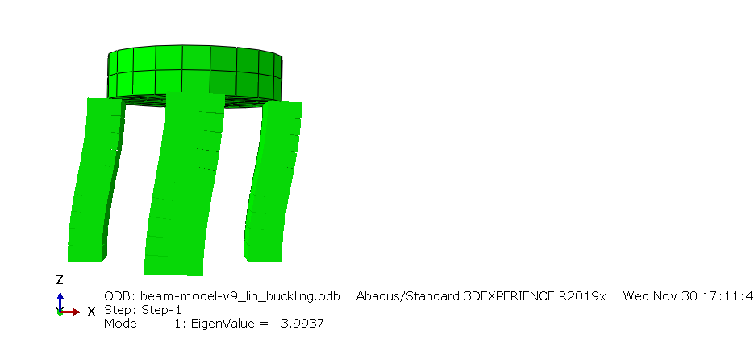
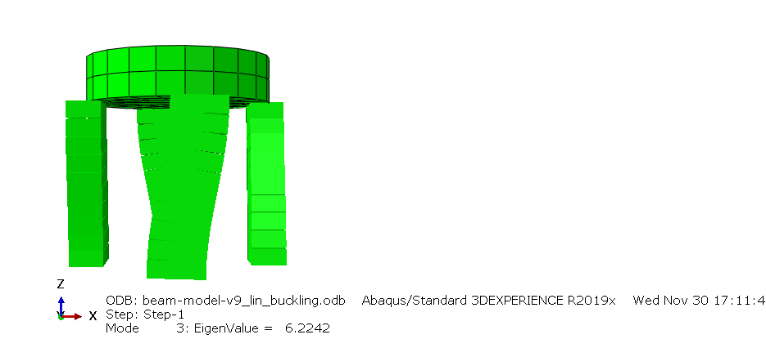


Buckling of Beam Model
$$λ=3.9937$$
$$λ=6.2242$$

Slide 19
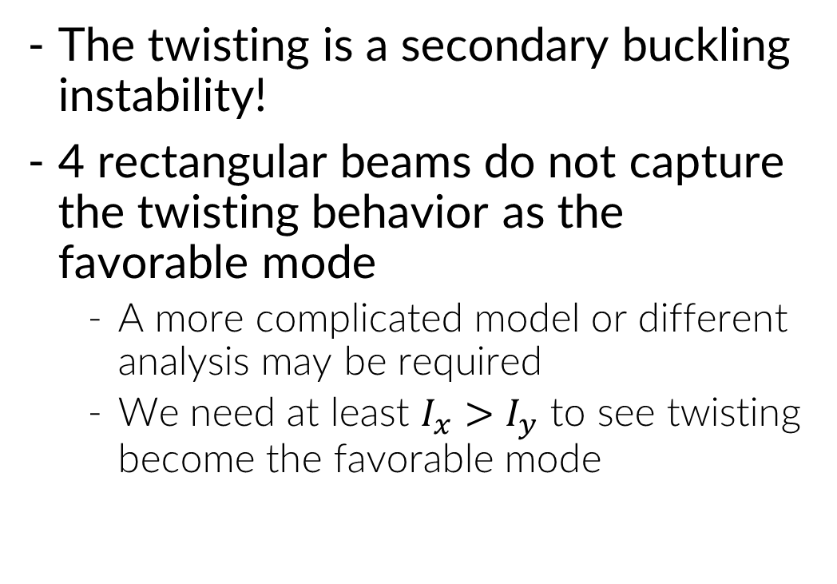
Conclusions and Future Work
The twisting is a secondary buckling instability!
4 rectangular beams do not capture the twisting behavior as the favorable mode
A more complicated model or different analysis may be required
We need at least $I_{x}>I_{y}$ to see twisting become the favorable mode

Slide 20
Thanks for listening!

Slide 21
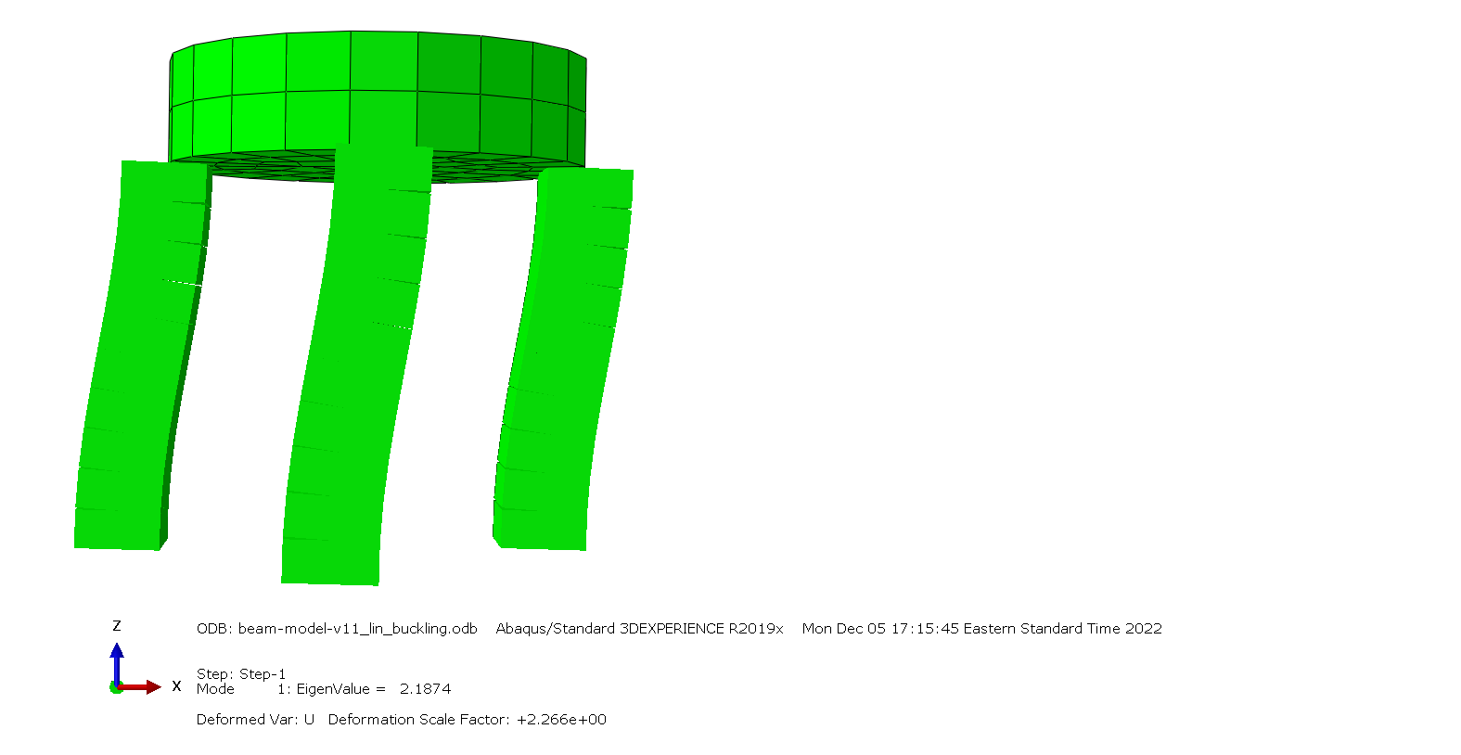
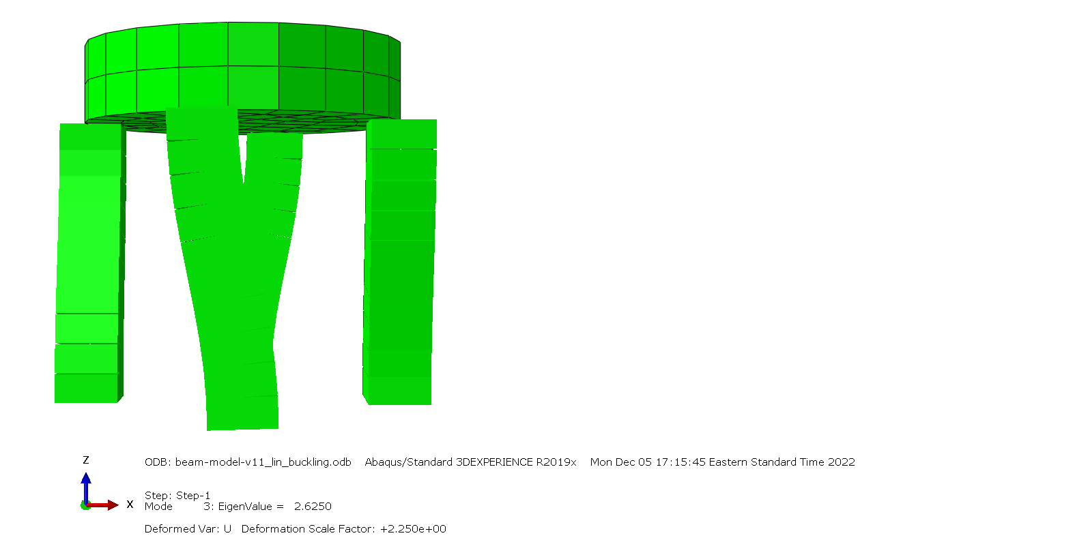


What if it’s a square?!
$$λ=2.1874$$
$$λ=2.6250$$

